Slide 1


Noida Institute of Engineering and Technology, Greater Noida
High Performance Computing
Unit: II
High Performance Computing
Mr. Anshul Varshney
Assisstant Professor
Department of CS
( B Tech 2nd Year)

Slide 2

Faculty Profile
FACULTY PROFILE
Name of Faculty: Mr. Anshul Varshney
Designation & Department: Assisstant Professor , CS Dept.
Qualification: B.C.A, M.C.A. MTech & Pursuing PhD
Experience: Have 10 years experience of Teaching subjects such as, Automata, Design Analysis Software Engineering, Python and C programming language

Slide 3


Evaluation Scheme
B.Tech. (Computer Science CS)
Core subject
3rd SEMESTER
PREDICTIVE ANALYTICS

Slide 4

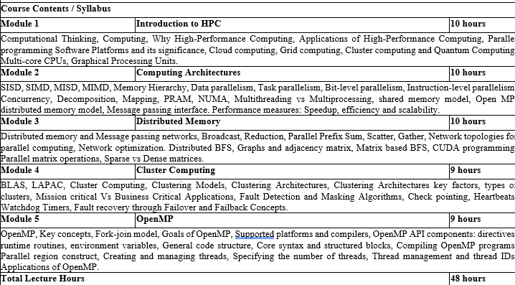
Course Contents / Syllabus

Slide 5
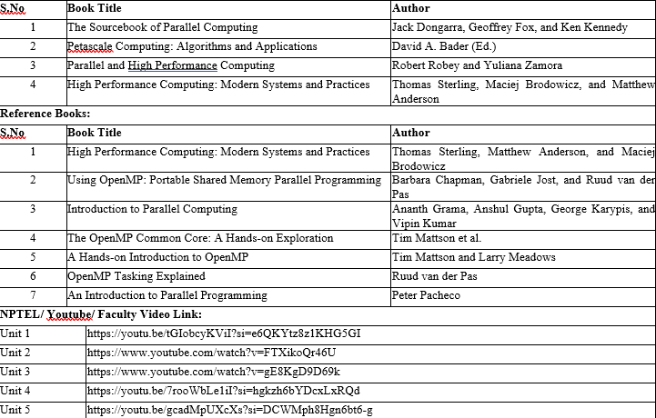
Book Title/ External Links as per Syllabus

Slide 6

Branch wise Applications
Computer science encompasses a diverse array of specialized fields that address modern technological challenges and innovations. Artificial Intelligence (AI) & Machine Learning (ML) empower systems to perceive, learn, and make decisions—from voice assistants and medical diagnostic tools to autonomous vehicles . Data Science & Big Data blend statistics, data modeling, and programming to uncover insights for business intelligence, fraud detection, and predictive analytics. Software Engineering focuses on the full lifecycle of building robust applications—from mobile and web platforms to enterprise and industrial systems . In Cybersecurity & Cryptography, specialists design secure protocols and systems to protect networks, financial infrastructure, and sensitive personal data. Cloud Computing & DevOps enable scalable on-demand services, powering online gaming, streaming, and enterprise applications with automated deployment pipelines . Fields like Computer Graphics & Visualization, Computer Vision, and HCI focus on visual, interactive, and user-centric computing, driving VR/AR, gaming, medical imaging, and intuitive interfaces. Algorithms & Data Structures form the theoretical backbone, optimizing search, encryption, and data retrieval while informing compiler and database design. At the hardware level, Computer Architecture & Embedded Systems support IoT, smart devices, and robotics through efficient design of processors and sensors . Blockchain & Distributed Systems revolutionize secure, decentralized applications in finance and supply chains. Emerging areas like Quantum Computing and Neuromorphic/Biological Computing promise breakthroughs in simulation, optimization, and ultra-efficient intelligent systems—whether using qubits to accelerate drug discovery or neuronal circuits to mimic brain-like computation .

Slide 7
Course Objective
The objective of this course is -
Fundamental HPC Concepts & Terminology Introduce students to essential HPC concepts like parallelism, scaling, and performance (speedup vs. efficiency). Explain why HPC is vital across scientific and engineering domains
Understanding Modern Architectures Cover shared‑memory and distributed systems (clusters, GPUs, accelerators), their architectures, and how hardware design influences software performance.
Mastery of Parallel Programming Models Teach key parallel programming paradigms:
Shared memory: OpenMP
Distributed memory: MPI
Hardware-accelerated: CUDA, OpenCL, OpenACC

Slide 8
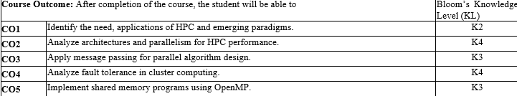

Course Outcomes

Slide 9
Program Outcomes
Engineering Graduates will be able to Understand:
1. Engineering knowledge
2. Problem analysis
3. Design/development of solutions
4. Conduct investigations of complex
5. Modern tool usage
6. The engineer and society
7. Environment and sustainability
8. Ethics
9. Individual and team work
10. Communication
11. Project management and finance
12. Life-long learning

Slide 10
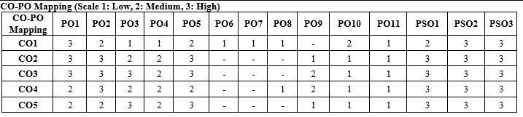
CO-PO Mapping

Slide 11
Program Specific Outcomes (PSOs)
PSO’s
At the end of the program, the student will be able to-
PSO 1: Apply suitable techniques, modern tools to solve complex engineering problems in the field of computer science.
PSO 2: Design and optimize, ethical and innovative solutions for the betterment of the society.
PSO 3: Work as an individual or lead in a team with good communication and engage in life-long learning.

Slide 12
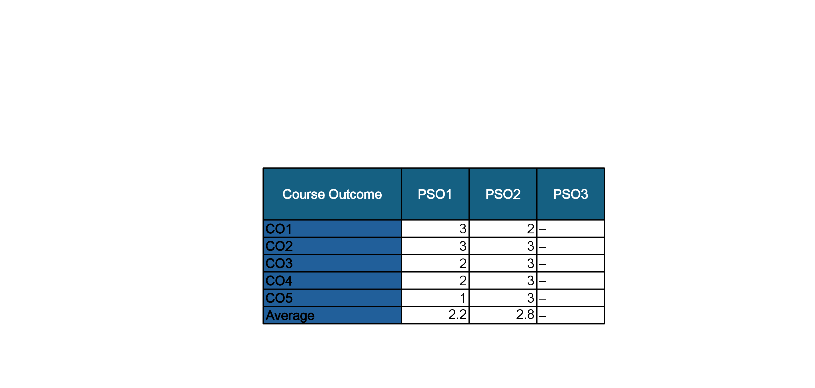
COs and PSOs Mapping

Slide 13
Program Educational Objectives (PEOs)
PEO’s
The graduates of B.Tech Computer Science program will-
PEO1: Have successful careers in the field of Computer Science and pursue higher education.
PEO2: Engage in research and provide innovative solution to real world problems of the society with ethical responsibilities.
PEO3: Demonstrate effective communication, work as an individual or as a team and engage in life-long learning.

Slide 14
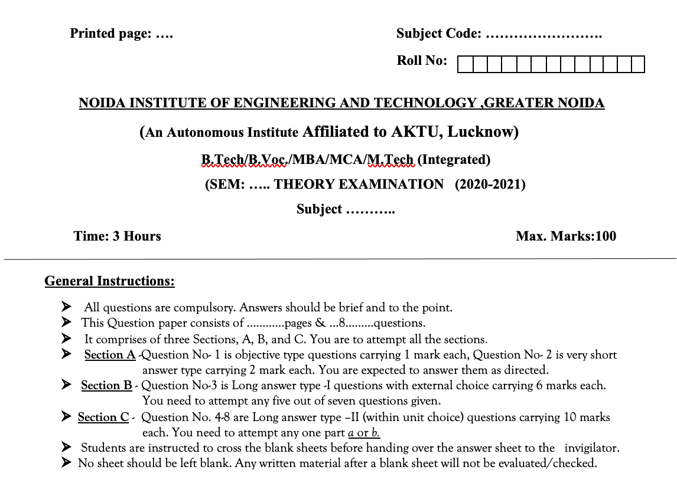
Question Paper Template

Slide 15
Question Paper Template
 |  | SECTION – A |  | CO
 | Attempt all parts- |  | [10×1=10]
 | 1-a. | Question- | (1)
 | 1-b. | Question- | (1)
 | 1-c. | Question- | (1)
 | 1-d. | Question- | (1)
 | 1-e. | Question- | (1)
 | 1-f. | Question- | (1)
 | 1-g. | Question- | (1)
 | 1-h. | Question- | (1)
 | 1-i. | Question- | (1)
 | 1-j. | Question- | (1)
2. | Attempt all parts- |  | [5×2=10] | CO
 | 2-a. | Question- | (2)
 | 2-b. | Question- | (2)
 | 2-c. | Question- | (2)
 | 2-d. | Question- | (2)
 | 2-e. | Question- | (2)
SECTION – B |  |  |  | CO
3. | Answer any five of the following- |  | [5×6=30]
 | 3-a. | Question- | (6)
 | 3-b. | Question- | (6)
 | 3-c. | Question- | (6)
 | 3-d. | Question- | (6)
 | 3-e. | Question- | (6)
 | 3-f. | Question- | (6)
 | 3-g. | Question- | (6)
SECTION – C |  |  |  | CO
4 | Answer any one of the following- |  | [5×10=50]
 | 4-a. | Question- | (10)
 | 4-b. | Question- | (10)
5. | Answer any one of the following-
 | 5-a. | Question- | (10)
 | 5-b. | Question- | (10)
6. | Answer any one of the following-
 | 6-a. | Question- | (10)
 | 6-b. | Question- | (10)
7. | Answer any one of the following-
 | 7-a. | Question- | (10)
 | 7-b. | Question- | (10)
8. | Answer any one of the following-
 | 8-a. | Question- | (10)
 | 8-b. | Question- | (10)

Slide 16
Result Analysis
Subject Result: NA
Department Result: NA
Faculty-Wise Result: NA

Slide 17
Prerequisite and Recap
Prerequisites:
Programming Fundamentals:
Languages: Proficiency in C, C++, or Fortran – essential for working
Recap:
High-Performance Computing, Applications of High-Performance Computing

Slide 18
Brief Intro of Subject with video
High Performance Computing (HPC) focuses on solving complex computational problems using parallel and distributed computing technologies. In today’s era of large-scale data and simulation-driven systems, HPC enables faster processing and analysis by harnessing the power of modern hardware and software tools like multi-core processors, clusters, grids, and even quantum systems.
Students learn:
Core concepts of parallelism
Architectural models like SIMD, MIMD
Programming using OpenMP and MPI
Fault-tolerant mechanisms in cluster systems
This course builds the foundation to design, implement, and analyze performance-driven software and systems used in scientific research, machine learning, big data, etc.
Topic-wise Video Lectures (YouTube/NPTEL)
Unit 2 Introduction to HPC & Paradigms https://www.youtube.com/watch?v=tGIobcyKViI

Slide 19
CONTENTS
Introduction to Computing Architectures
A computing architecture defines the design and structure of a computer system, including how data flows, how memory is accessed, and how instructions are executed. It’s the blueprint that determines how efficiently hardware and software can perform tasks — especially important in High Performance Computing (HPC).
Types of Architectures
SISD (Single Instruction, Single Data):
SIMD (Single Instruction, Multiple Data):
MISD (Multiple Instruction, Single Data):
MIMD (Multiple Instruction, Multiple Data):

Slide 20
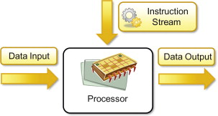
Single-instruction, single-data (SISD) systems
An SISD computing system is a uniprocessor machine capable of executing a single instruction, which operates on a single data stream see Figure. In SISD, machine instructions are processed sequentially; hence computers adopting this model are popularly called sequential computers. Most conventional computers are built using the SISD model. All the instructions and data to be processed have to be stored in primary memory. The speed of the processing element in the SISD model is limited by the rate at which the computer can transfer information internally. Dominant representative SISD systems are IBM PC, Macintosh, and workstations.

Slide 21
Single-instruction, single-data (SISD) systems
Most Arm instructions are Single Instruction Single Data (SISD). Each instruction performs its specified operation on a single data source. Processing multiple data items therefore requires multiple instructions. For example, to perform four addition operations requires four instructions to add values from four pairs of registers:
ADD w0, w0, w5
ADD w1, w1, w6
ADD w2, w2, w7
ADD w3, w3, w8
This method is relatively slow and it can be difficult to see how different registers are related. To improve performance and efficiency, media processing is often off-loaded to dedicated processors such as a Graphics Processing Unit (GPU) or Media Processing Unit which can process more than one data value with a single instruction.

Slide 22
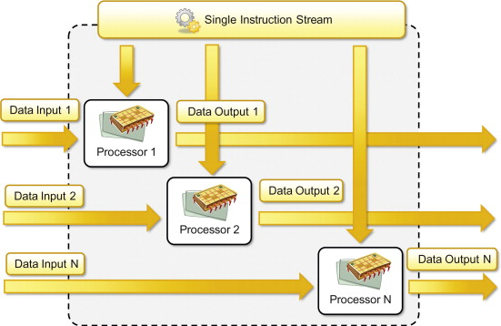
Single Instruction, Multiple Data(SIMD) systems
SIMD stands for Single Instruction, Multiple Data. This powerful approach allows a single CPU instruction to process multiple data points simultaneously. Imagine you're working with an image or two vectors. Normally, operations on these data points would be performed one at a time - a method known as scalar operation. However, with SIMD optimization, these operations can be vectorized, meaning multiple data points are processed in one go. SIMD architectures typically organize data into vectors or arrays, enabling synchronized execution and faster computational throughput.

Slide 23
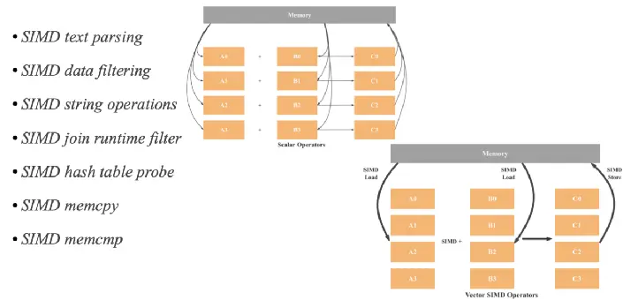
Single Instruction, Multiple Data(SIMD) systems
How SIMD Works

Slide 24
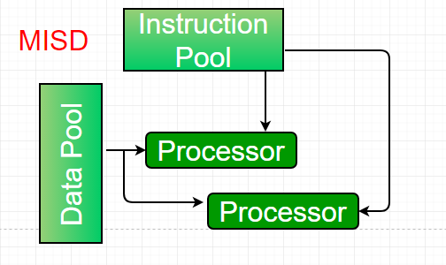
Multiple-instruction, single-data (MISD) systems
Multiple Instruction, Single Data (MISD) is a parallel computing architecture where multiple processors execute different instructions on the same data stream. While not widely implemented in commercially available systems, it's a concept primarily of theoretical interest. MISD principles are sometimes found in pipeline architectures and fault-tolerant systems.
An MISD computing system is a multiprocessor machine capable of executing different instructions on different PEs but all of them operating on the same dataset .

Slide 25
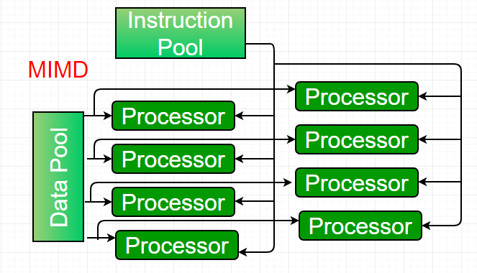
Multiple-instruction, multiple-data (MIMD) systems
An MIMD system is a multiprocessor machine which is capable of executing multiple instructions on multiple data sets. Each PE in the MIMD model has separate instruction and data streams; therefore machines built using this model are capable to any kind of application. Unlike SIMD and MISD machines, PEs in MIMD machines work asynchronously.

Slide 26
Multiple-instruction, multiple-data (MIMD) systems
MIMD machines are broadly categorized into shared-memory MIMD and distributed-memory MIMD based on the way PEs are coupled to the main memory. In the shared memory MIMD model (tightly coupled multiprocessor systems), all the PEs are connected to a single global memory and they all have access to it. The communication between PEs in this model takes place through the shared memory, modification of the data stored in the global memory by one PE is visible to all other PEs. Dominant representative shared memory MIMD systems are Silicon Graphics machines and Sun/IBM’s SMP (Symmetric Multi-Processing).
The shared-memory MIMD architecture is easier to program but is less tolerant to failures and harder to extend with respect to the distributed memory MIMD model. Failures in a shared-memory MIMD affect the entire system, whereas this is not the case of the distributed model, in which each of the PEs can be easily isolated. Moreover, shared memory MIMD architectures are less likely to scale because the addition of more PEs leads to memory contention.

Slide 27
Memory Hierarchy
In the Computer System Design, Memory Hierarchy is an enhancement to organize the memory such that it can minimize the access time. The Memory Hierarchy was developed based on a program behavior known as locality of references (same data or nearby data is likely to be accessed again and again). The figure below clearly demonstrates the different levels of the memory hierarchy.
Types of Memory Hierarchy
External Memory or Secondary Memory: Comprising of Magnetic Disk, Optical Disk, and Magnetic Tape i.e. peripheral storage devices which are accessible by the processor via an I/O Module.
Internal Memory or Primary Memory: Comprising of Main Memory, Cache Memory & CPU registers. This is directly accessible by the processor.

Slide 28
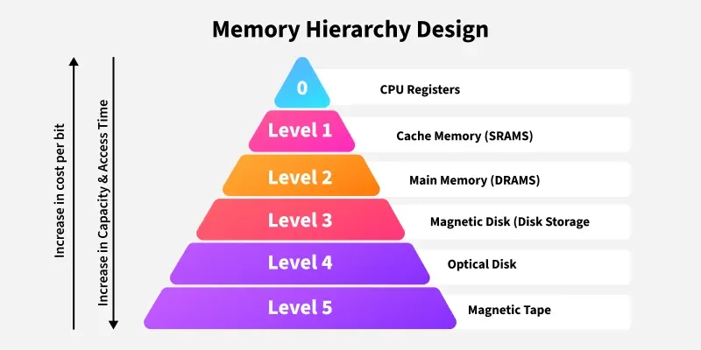
Memory Hierarchy

Slide 29
Memory Hierarchy Design
Memory Hierarchy Design
Registers: Registers are small, high-speed memory units located in the CPU.
Cache Memory: Cache memory is a small, fast memory unit located close to the CPU.
Main Memory: Main memory, also known as RAM (Random Access Memory), is the primary memory of a computer system.
Types of Main Memory
Static RAM: Static RAM stores the binary information in flip flops and information remains valid until power is supplied.
Dynamic RAM:It stores the binary information as a charge on the capacitor. It requires refreshing circuitry to maintain the charge on the capacitors after a few milliseconds.
Secondary Storage: Secondary storage, such as hard disk drives (HDD) and solid-state drives (SSD) , is a non-volatile memory unit that has a larger storage capacity than main memory.

Slide 30
Memory Hierarchy Design
Cont……
Magnetic Disk: Magnetic Disks are simply circular plates that are fabricated with either a metal or a plastic or a magnetized material.
Magnetic Tape: Magnetic Tape is simply a magnetic recording device that is covered with a plastic film. Magnetic Tape is generally used for the backup of data.
Characteristics of Memory Hierarchy
Capacity: It is the global volume of information the memory can store. As we move from top to bottom in the Hierarchy, the capacity increases.
Access Time: It is the time interval between the read/write request and the availability of the data. As we move from top to bottom in the Hierarchy, the access time increases.
Performance: The Memory Hierarch design ensures that frequently accessed data is stored in faster memory to improve system performance.
Cost Per Bit: As we move from bottom to top in the Hierarchy, the cost per bit increases i.e. Internal Memory is costlier than External Memory.

Slide 31
Introduction to Parallel Computing
Computer software was written conventionally for serial computing. This meant that to solve a problem, an algorithm divides the problem into smaller instructions. These discrete instructions are then executed on the Central Processing Unit of a computer one by one. Only after one instruction is finished, next one starts.
It is the use of multiple processing elements simultaneously for solving any problem. Problems are broken down into instructions and are solved concurrently as each resource that has been applied to work is working at the same time.
Types of Parallelism:
Data-level parallelism (DLP)
Task Parallelism
Bit-level parallelism
Instruction-level parallelism

Slide 32
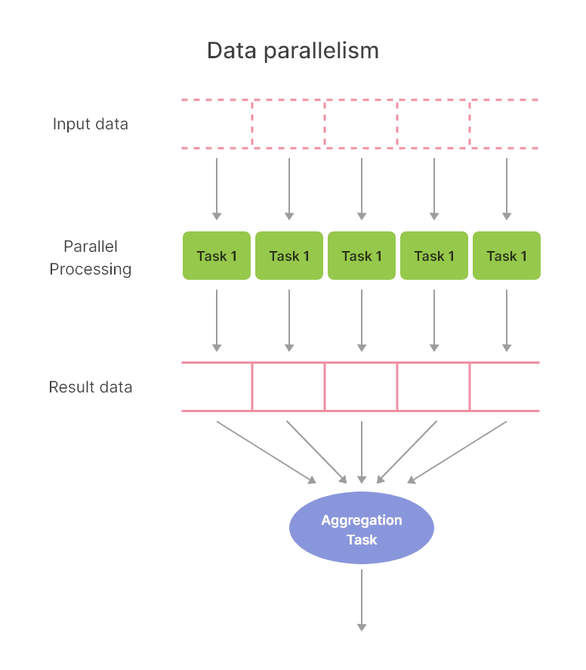
Data Parallelism
Data parallelism is a parallel computing paradigm in which a large task is divided into smaller, independent, simultaneously processed subtasks. Via this approach, different processors or computing units perform the same operation on multiple pieces of data at the same time. The primary goal of data parallelism is to improve computational efficiency and speed.

Slide 33
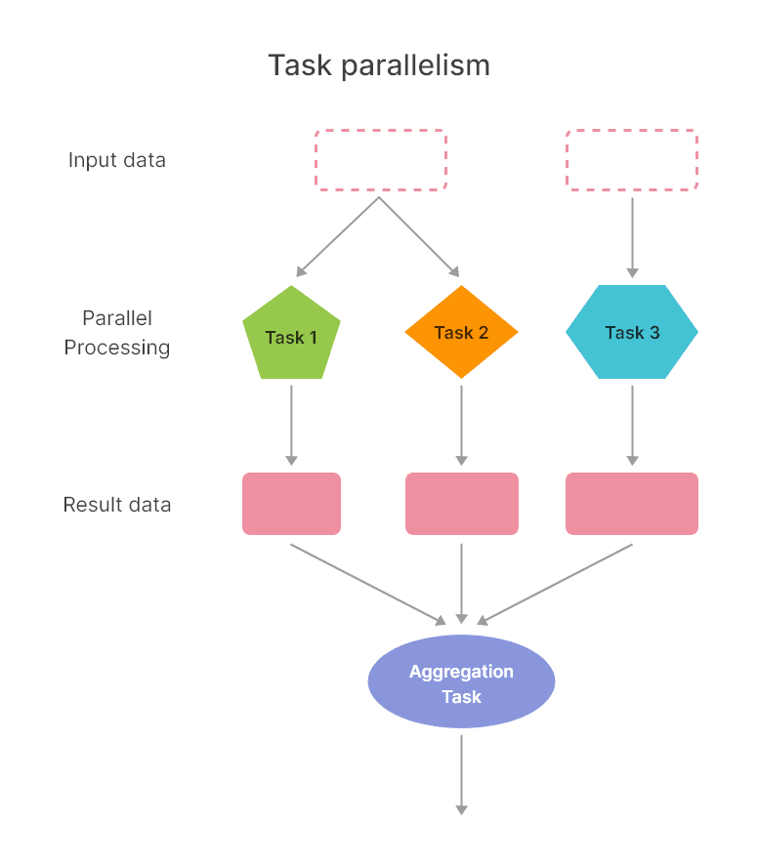
Task Parallelism
Task Parallelism means concurrent execution of the different task on multiple computing cores.
Consider again our example above, an example of task parallelism might involve two threads, each performing a unique statistical operation on the array of elements. Again The threads are operating in parallel on separate computing cores, but each is performing a unique operation.

Slide 34
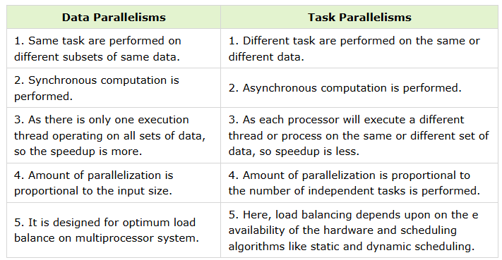
Data Parallelism Vs Task Parallelism
The key differences between Data Parallelisms and Task Parallelisms are:

Slide 35
Bit-level parallelism
Bit-level parallelism is a form of parallel computing where the word size of a processor is increased to handle more bits of data in a single operation. This optimization improves computational efficiency by reducing the number of instructions a processor must execute for certain operations, particularly arithmetic computations.
Bit-level parallelism focuses on exploiting the inherent parallelism in binary arithmetic. By increasing the width of data processed simultaneously (e.g., moving from 8-bit to 16-bit, or 32-bit to 64-bit systems), processors can execute computations more efficiently. This architectural design aims to optimize operations like addition, subtraction, multiplication, and logical operations by processing more bits in a single clock cycle.

Slide 36
Bit-level parallelism
Applications of Bit-level Parallelism
Bit-level parallelism is essential in various fields that require efficient data processing and high-speed computation:
Cryptography: Efficient handling of large bit-lengths improves encryption and decryption speeds.
Digital Signal Processing (DSP): Processes like audio and image compression benefit from parallel data handling.
High-performance Computing: Scientific simulations and complex numerical algorithms leverage increased word sizes for faster calculations.
Graphics Processing: Enhances rendering and processing of high-definition images and videos.
Database Management: Bit-level parallelism aids in faster querying and data manipulation.

Slide 37
Instruction Level Parallelism
Is used to refer to the architecture in which multiple operations can be performed parallelly in a particular process, with its own set of resources - address space, registers, identifiers, state, and program counters.
It refers to the compiler design techniques and processors designed to execute operations, like memory load and store, integer addition, and float multiplication, in parallel to improve the performance of the processors.
Classification of ILP Architectures
The classification of ILP architectures can be done in the following ways -
Sequential Architecture: Here, the program is not expected to explicitly convey any information regarding parallelism to hardware, like superscalar architecture.
Dependence Architectures: Here, the program explicitly mentions information regarding dependencies between operations like dataflow architecture.
Independence Architecture: Here, programme m gives information regarding which operations are independent of each other so that they can be executed instead of the 'nops.

Slide 38
Concurrency
Concurrency refers to an application that is doing many tasks at the same time. Concurrency is a technique for reducing system response time by utilizing a single processing unit. Concurrency offers the illusion of parallelism, however, the chunks of a job aren’t performed in parallel, and inside the application, more than one task is being executed at the same time. It does not complete one work before beginning the next.
Concurrency is achieved by the interleaving of processes on the central processing unit (CPU), also known as context switching. That is the logic behind parallel processing. It enhances the quantity of work that can be completed at one time.

Slide 39
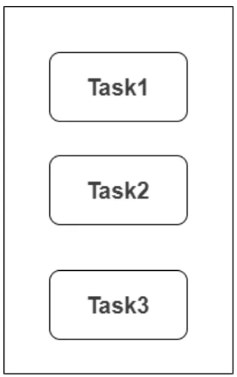
Concurrency
Threading, asynchrony, and pre-emptive multitasking are the three basic kinds of concurrent computing. Each technique has its own set of unique precautions that must be followed to avoid race situations, which occur when several threads or processes access the same shared data in memory in the wrong sequence.
Multiple tasks can be seen progressing at the same time in the image above. This diagram depicts concurrency because concurrency is a strategy that works with many things at once.

Slide 40
Concurrency
If a computer system is a multiprocessing system, then a single problem/program must be divided into subproblems in order to assign them to the processors. In order to perform this task a technique, Problem decomposition is used. It is the process of decomposing a problem/program into multiple subproblems/subprograms. It is the basic building block of Parallel Computing.
Types of Decomposition:
Domain Decomposition (Data Decomposition):
The problem is divided based on the data.
Each processor handles a portion of the data.
Suitable for numerical simulations, image processing, etc.
Functional Decomposition (Task Decomposition):
The problem is divided based on tasks or functions.
Each processor performs a different task.
Useful when different operations are applied to the same data.

Slide 41
Concurrency
After a problem is decomposed, the next step in parallel programming is Mapping. Mapping is the process of assigning decomposed tasks or data units to specific processing elements (PEs) like CPU cores, GPU threads, or nodes in a cluster.
Types of Mapping:
Static Mapping (Compile-Time Mapping)
Tasks are assigned to processors before execution.
Simpler and faster, but not adaptive.
Best when workload and resources are predictable.
Dynamic Mapping (Run-Time Mapping)
Tasks are assigned during execution.
Adapts to load imbalance, failures, etc.
Often used in distributed systems and task pools.

Slide 42
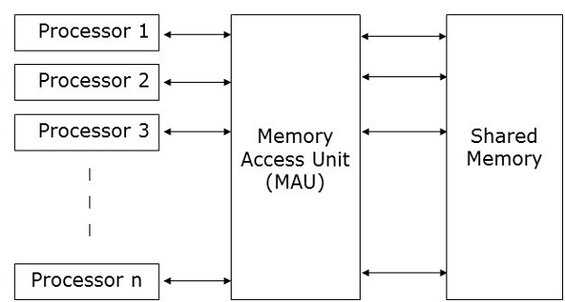
Parallel Random Access Machine
PRAM is a theoretical model used in parallel computing to design and analyze parallel algorithms. It simplifies the complexities of real-world hardware to focus purely on algorithm design, efficiency, and parallelism.
PRAM Architecture Model
Parallel Random Access Machine, also called PRAM is a model considered for most of the parallel algorithms. It helps to write a precursor parallel algorithm without any architecture constraints and also allows parallel-algorithm designers to treat processing power as unlimited. It ignores the complexity of inter-process communication. PRAM algorithms are mostly theoretical but can be used as a basis for developing an efficient parallel algorithm for practical machines and can also motivate building specialized machines.

Slide 43
Parallel Random Access Machine
To solve this problem, the following constraints have been enforced on PRAM model
Exclusive Read Exclusive Write (EREW) − Here no two processors are allowed to read from
or write to the same memory location at the same time.
Exclusive Read Concurrent Write (ERCW) − Here no two processors are allowed to read
from the same memory location at the same time, but are allowed to write to the same memory location at the same time.
Concurrent Read Exclusive Write (CREW) − Here all the processors are allowed to read from the same memory location at the same time, but are not allowed to write to the same memory location at the same time.
Concurrent Read Concurrent Write (CRCW) − All the processors are allowed to read from
or write to the same memory location at the same time.

Slide 44
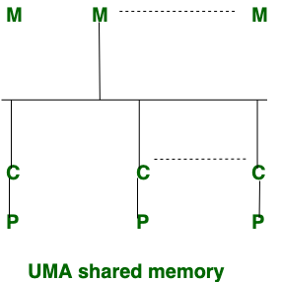
Uniform Memory Access Non-Uniform Memory Access
Uniform Memory Access (UMA):
In UMA, where Single memory controller is used. Uniform Memory Access is slower than non-uniform Memory Access. In Uniform Memory Access, bandwidth is restricted or limited rather than non-uniform memory access. There are 3 types of buses used in uniform Memory Access which are: Single, Multiple and Crossbar. It is applicable for general purpose applications and time-sharing applications.

Slide 45
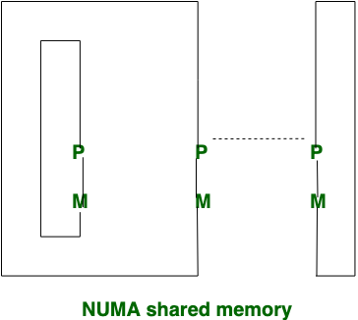
Uniform Memory Access Non-Uniform Memory Access
Non-Uniform Memory Access (NUMA):
In NUMA, where different memory controller is used. Non-uniform Memory Access is faster than uniform Memory Access. Non-uniform Memory Access is applicable for real-time applications and time-critical applications.

Slide 46
Uniform Memory Access Non-Uniform Memory Access
Difference between UMA and NUMA
Feature | UMA | NUMA
Latency | Uniform across all CPUs | Lower for local node, higher for remote
Memory Controllers | Single centralized | Multiple (one per node)
Scalability | Limited beyond few CPUs | Highly scalable
Implementation Cost | Lower, simpler hardware/software | Higher, more complex
Bandwidth | Shared, becomes bottleneck under load | Higher total bandwidth via nodes

Slide 47
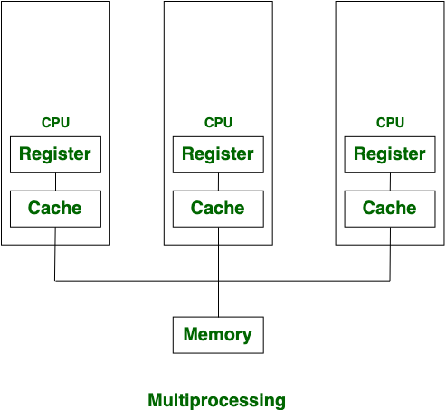
Multithreading vs Multiprocessing
Multiprocessing:
Multiprocessing is a system that has more than one or two processors. In Multiprocessing, CPUs are added to increase the computing speed of the system. Because of Multiprocessing, There are many processes are executed simultaneously. Explore more about similar topics. Multiprocessing is classified into two categories:
1. Symmetric Multiprocessing 2. Asymmetric Multiprocessing
Advantages
Increases computing power by utilizing multiple processors.
Suitable for tasks that require heavy computational power.
Disadvantages
Process creation is time-consuming.
Each process has its own address space, which can lead to higher memory usage.

Slide 48
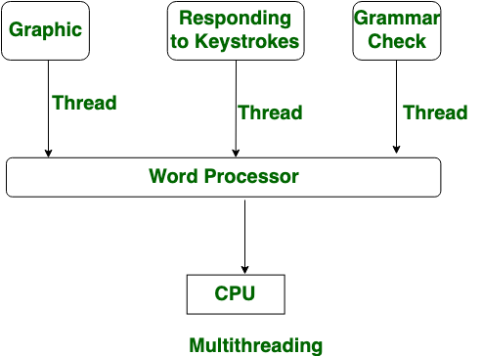
Multithreading vs Multiprocessing
Multithreading:
Multithreading is a system in which multiple threads are created of a process for increasing the computing speed of the system. In multithreading, many threads of a process are executed simultaneously and process creation in multithreading is done according to economical.
Advantages
More efficient than multiprocessing for tasks within a single process.
Threads share a common address space, which is memory-efficient.
Disadvantages
Not classified into categories like multiprocessing.
Thread creation is economical but can lead to synchronization issues.

Slide 49
Multithreading vs Multiprocessing
Difference Between Multiprocessing and Multithreading
Multiprocessing | Multithreading
In Multiprocessing, CPUs are added for increasing computing power. | While In Multithreading, many threads are created of a single process for increasing computing power.
In Multiprocessing, Many processes are executed simultaneously. | While in multithreading, many threads of a process are executed simultaneously.
Multiprocessing are classified into Symmetric and Asymmetric. | While Multithreading is not classified in any categories.
In Multiprocessing, Process creation is a time-consuming process. | While in Multithreading, process creation is according to economical.
In Multiprocessing, every process owned a separate address space. | While in Multithreading, a common address space is shared by all the threads.

Slide 50
Shared Memory
Shared Memory:
Shared Memory is a concept of Operating Systems and is mainly used in Inter-process Communication. If two processes want to share data with each other, they need some intermediate medium to do so and this is where shared memory comes into the picture.
Every process has a dedicated address space in order to store data. If a process wants to share some data with another process, it cannot directly do so since they have different address spaces. In order to share some data, a process takes up some of the address space as shared memory space. This shared memory can be accessed by the other process to read/write the shared data.
Let us consider two processes P1 and P2 that want to perform Inter-process communication using a shared memory.
P1 has an address space, let us say A1 and P2 has an address space, let us say A2. Now, P1 takes up some of the available address space as a shared memory space, let us say S1. Since P1 has taken up this space, it can decide which other processes can read and write data from the shared memory space.
For now, we will assume that P1 has given only reading rights to other processes with respect to the shared memory. So, the flow of Inter-process communication will be as follows:

Slide 51
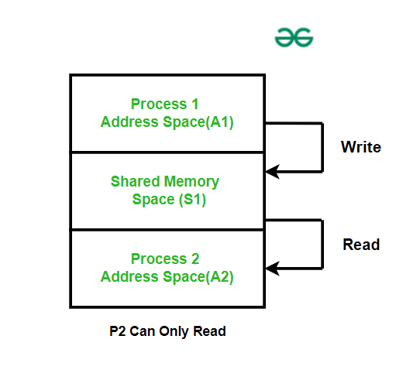
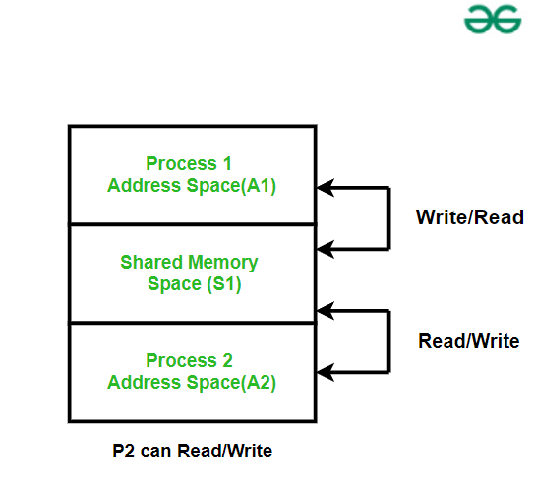
Shared Memory
Shared Memory:
Process P1 takes up some of the available space as shared memory S1
Process P1 writes the data to be shared in S1
Process P2 reads the shared data from S1
Now, let us assume that P1 has given write rights to P2 as well. So the communication will shown in the below diagram:
Since P1 took up the space for shared memory i.e. since process P1 is the creator process, only it has the right to destroy the shared memory as well.

Slide 52
Shared Memory
Use Cases of Shared Memory
Inter-Process Communication: Shared memory is primarily used in IPC where two processes need a shared address space in order to exchange data.
Parallel Processing: Multiple processes can share and modify data in the shared address space, thereby speeding up computations.
Databases: Shared memory is used in databases, in the form of cache, so that reading and writing of data can be much faster
Graphics and Multimedia Applications: CPU and GPU can access data concurrently which is helpful in tasks such as video manipulation and processing.
Distributed Systems: Two different machines can access data from a shared space and work as a single system.

Slide 53
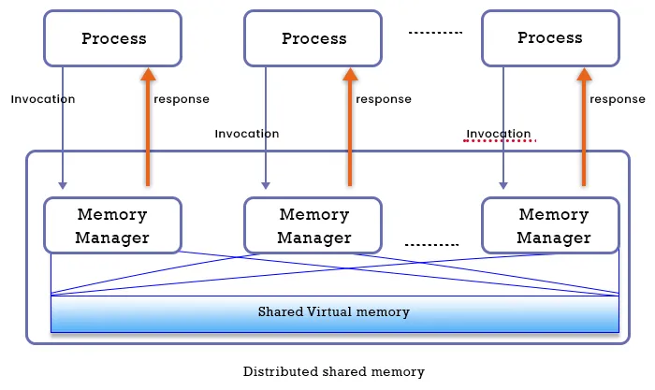
DISTRIBUTED MEMORY MODEL
DISTRIBUTED MEMORY MODEL
A system with DSM is made up of a number of nodes or computers that are linked together by a network, and each have their own local memory. All of the nodes’ shared memory is managed by the DSM system. Transparent connections and processing take place between all nodes/computers. Additionally, the DSM ensures that each node is able to access virtual memory without any interference from other nodes. The DSM has no physical memory; instead, all of the nodes share a virtual space address, and data is transferred between them through the main memory.

Slide 54
DISTRIBUTED MEMORY MODEL
Now let’s talk about a few distinct varieties of distributed shared memory:
A) On-Chip Memory:
The CPU’s chip houses all of the data.
Memory and address lines have a direct link.
The On-Chip Memory DSM is extremely expensive and challenging.
B) Microprocessor based on buses:
Through a network of parallel wires that serves as a bus, the link between the memory and the CPU is made.
All computers adhere to certain standards while accessing memory, and an algorithm is put in place to stop multiple systems from using memory simultaneously.
The cache memory reduces network traffic.
C) Microprocessor with rings
There is no centralized memory in Ring-based DSM.
All nodes are linked together via a network, and token passing is used to access memory.
In this system, a single address line is accessible by all nodes/computers in the shared space.

Slide 55
Open Multi‑Processing
OpenMP (Open Multi‑Processing) is an open-standard API designed for shared-memory parallel programming in C, C++, and Fortran on a wide range of systems—desktops, servers, and supercomputers. It consists of a set of compiler directives, runtime routines, and environment variables that together enable developers to indicate parallel regions of code. Following a fork–join execution model, a single master thread spawns (forks) worker threads when a parallel region is encountered, all threads execute concurrently, then synchronize (join) back into the master thread upon completion. OpenMP supports flexible work distribution (loops, tasks, sections), thread synchronization (barriers, critical, atomic), and data-sharing attributes (shared, private, reduction), enabling safe and efficient concurrency. Governed by the OpenMP Architecture Review Board and implemented across major compilers (GCC, Clang, Intel, MSVC), OpenMP allows incremental, portable, and scalable parallelization of legacy code with minimal changes

Slide 56
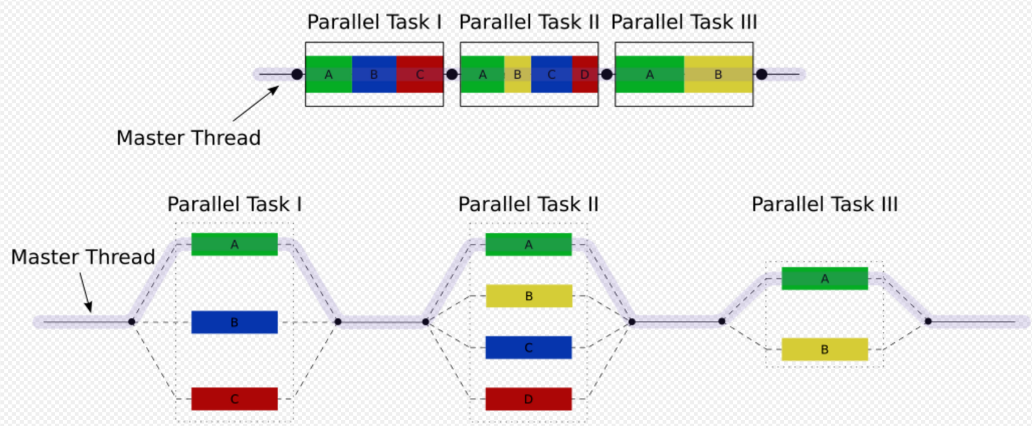
Open Multi‑Processing

Slide 57
Open Multi‑Processing
THREAD Vs PROCESS
A process is created by the OS to execute a program with given resources(memory, registers); generally, different processes do not share their memory with another. A thread is a subset of a process, and it shares the resources of its parent process but has its own stack to keep track of function calls. Multiple threads of a process will have access to the same memory.
OpenMP comes under the shared memory concept. In this, different CPU's (processors) will have access to the same memory location. Since all CPU's connect to the same memory, memory access should be handled carefully.

Slide 58
Message Passing Interface
Message passing interface (MPI) is a standard specification of message-passing interface for parallel computation in distributed-memory systems. MPI isn’t a programming language. It’s a library of functions that programmers can call from C, C++, or Fortran code to write parallel programs. With MPI, an MPI communicator can be dynamically created and have multiple processes concurrently running on separate nodes of clusters. Each process has a unique MPI rank to identify it, its own memory space, and executes independently from the other processes. Processes communicate with each other by passing messages to exchange data. Parallelism occurs when a program task gets partitioned into small chunks and distributes those chunks among the processes, in which such each process processes its part.

Slide 59
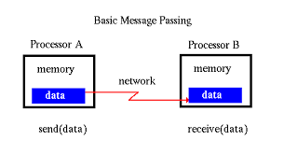
Message Passing Interface

Slide 60
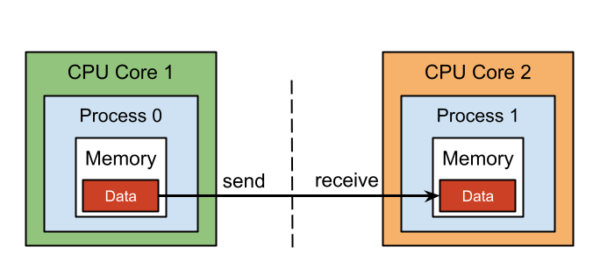
Message Passing Interface
MPI Communication Methods
MPI provides three different communication methods that MPI processes can use to communicate with each other. The communication methods are discussed as follows:
Point-to-Point Communication
MPI Point-to Point communication is the most used communication method in MPI. It involves the transfer of a message from one process to a particular process in the same communicator. MPI provides blocking (synchronous) and non-blocking (asynchronous) Point-to-Point communication.

Slide 61
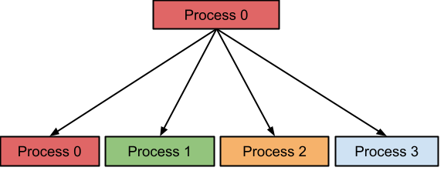
Message Passing Interface
Collective Communication
With this type of MPI communication method, a process broadcasts a message is to all processes in the same communicator including itself.
One-sided communication
With the MPI One-sided communication method, a process can directly access the memory space of another process without involving it.

Slide 62
Performance measures
Performance measures like speedup, efficiency, and scalability are crucial for evaluating the effectiveness of parallel algorithms and systems. Speedup indicates how much faster a parallel program runs compared to its sequential counterpart. Efficiency measures how well the available processors are utilized in a parallel program. Scalability describes the ability of a parallel system to maintain or improve performance as the problem size or number of processors increases.
Speedup (S) is the ratio of the execution time of the sequential version of a program to the execution time of its parallel version on 'p' processors. According to a search result, speedup is calculated as S(p) = T(1) / T(p).
Formula:
S(p) = T(sequential) / T(parallel, p processors)

Slide 63
Data Links
CONTENTS
https://www.youtube.com/watch?v=KVOc6369-Lo&t=2s
https://www.youtube.com/watch?v=MJ-ettBDJqQ
https://www.youtube.com/watch?v=OHijtcMGm9I&t=6s
https://www.youtube.com/watch?v=cRtSf8TLYcs

Slide 64
Daily Quiz
Which architecture supports multiple instructions on multiple data streams?** A) SISD B) SIMD C) MISD D) MIMD Answer: D) MIMD — multiple instruction & multiple data
MISD architecture is mainly used for:
A) GPUs B) Flight-control systems C) Web servers D) Database indexing
Answer: B) Flight-control systems
3. Fastest storage in the hierarchy is:
A) RAM B) Cache C) Hard disk D) Register
Answer: D) Register
In fully associative cache, what miss type cannot occur?
A) Conflict B) Capacity C) Cold D) Coherence
Answer: A) Conflict miss
Bit-level parallelism benefits from:
A) Wide ALUs B) Multithreading C) OpenMP D) MPI
Answer: A) Wide ALUs
Data parallelism is best illustrated by:
A) MPI B) OpenMP tasks C) SIMD vector instructions D) Pthreads
Answer: C) SIMD vector instructions

Slide 65
Daily Quiz
7. Task parallelism refers to:
A) Data replication B) Multiple threads on different tasks C) Single-core pipelines D) ALU bit ops
Answer: B) Threads performing different tasks
8. Concurrency means
A) Simultaneous threads B) Overlapping operations logically C) Sequential processing D) Speedup measure
Answer: B) Logical overlap of tasks
9. Mapping refers to:
A) Direct memory access B) Scheduling threads/tasks on resources C) Virtual memory translation D) MPI_Send order
Answer: B) Assigning tasks/data to cores/processors
10. MPI is designed for:
A) Multicore threads B) Shared memory C) Message passing in distributed memory D) GPU kernels
Answer: C) Distributed memory message passing

Slide 66
Weekly/monthly/Unit Wise Assignment.
Assignment
Explain Flynn’s taxonomy (SISD, SIMD, MISD, MIMD) and give a real-world example for each.
Why is MISD rare in practice? Describe one system that uses it.
Compare SIMD and MIMD in terms of instruction/data streams. Include performance trade-offs.
Define bit-level, instruction-level (ILP), data parallelism, and task parallelism. Provide an example of each.
What is concurrency? How does it differ from parallelism?
Define NUMA architecture. How does it differ from UMA, and what implications does it have for performance?
Explain the shared memory model and its advantages/challenges.
What are common MPI communication primitives? Categorize them (e.g., point-to-point vs collective)
List and explain at least three factors that limit parallel speedup and efficiency
What are false sharing and coherence misses? How can they be mitigated?

Slide 67
Expected Questions for University Exam
Explain why MISD is rare and give a notable example.
Compare SIMD and MIMD in terms of control and data parallel execution.
Define and differentiate bit-level, instruction-level (ILP), data, and task parallelism.
Define the assumptions of linear regression?
Define decomposition and mapping in parallel algorithm design and why they're critical.
Explain multithreading vs. multiprocessing concerning shared vs. isolated memory.
Describe the distributed memory model and the MPI communication paradigm.
Explain OpenMP, its core constructs, and typical directives.
Define speedup (S), efficiency (E), and scalability. Provide formulas.
Explain strong vs. weak scaling and how to measure each.

Slide 68
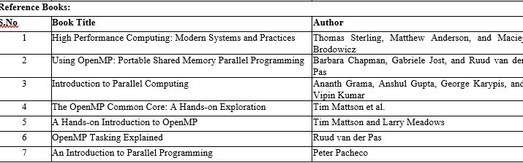
References

Slide 69
Recap
PRAM: Ideal shared-memory model with uniform access—unrealistic but useful for theoretical analysis.
NUMA: Actual shared-memory system with non-uniform memory access times, requiring data placement awareness.
Multithreading vs Multiprocessing: Threads share memory, processes don't; cost differences in creation and communication.
Mapping significance: Especially important in NUMA contexts to minimize remote memory access.

Slide 70
CONTENTS
Thank You

